Slide 1
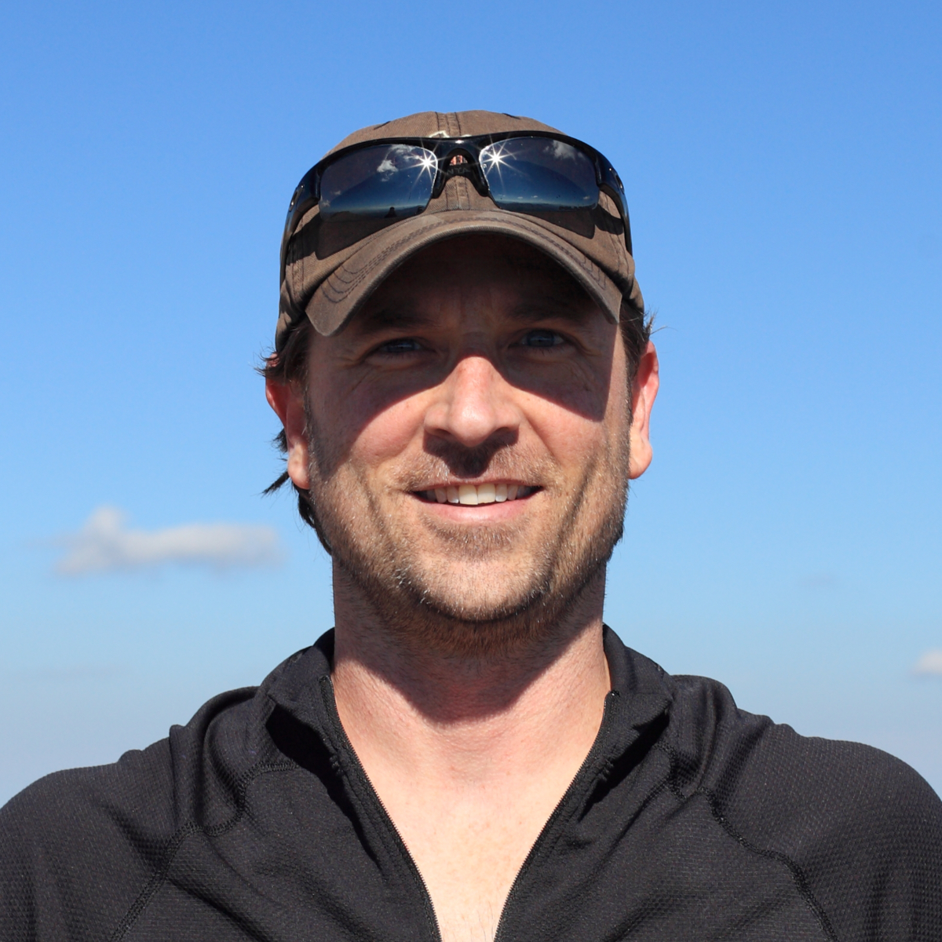




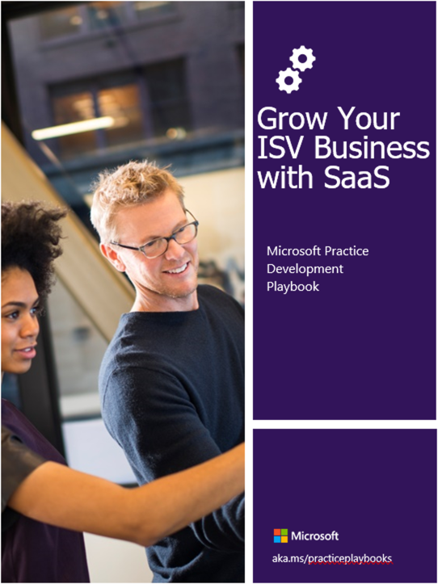
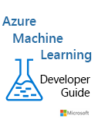
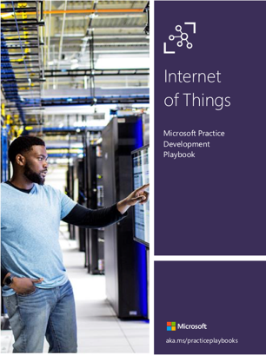
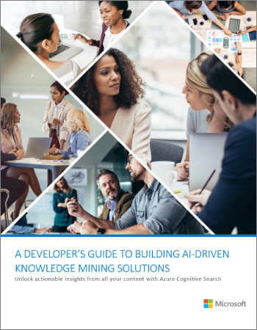


Kyle Bunting
Senior Data & AI Engineer
23+ years in IT
MBA, Krannert School of Management, Purdue University
Author / contributor of multiple books and whitepapers
kyle@solliance.net
https://github.com/kylebunting
https://www.linkedin.com/in/kylebunting

Slide 2

Chris Testa-O’Neill
Principal PM: Data and AI @ Microsoft
20+ years in Data and Analytics
6 years working at Microsoft
3 years in AI Engineering
3 years in World Wide Learning
20 years as Microsoft Certified Trainer
Chris.testaoneill@microsoft.com
https://github.com/ctesta-oneillmsft
https://www.linkedin.com/in/ctestaoneill

